Slide 1


PANIMALAR ENGINEERING COLLEGE
Department of Computer Science and Engineering
Third Project Review
GLUCOMA DETECTION IN HUMAN EYE
BATCH NO : F13
TEAM MEMBERS : P.VISWANATH (2017PECCS284) D.SATHISHKUMAR (2017PECCS261) G.R.VENKATESULU (2017PECCS277)
GUIDE : Dr.S.MURUGAVALLI

Slide 2
INTRODUCTION
GLAUCOMA is an unending and irreversible eye infection in which the optic nerve is consistently hurt, inciting disintegrating in vision and individual fulfillment. A significant learning structure is proposed remembering the ultimate objective to get a different leveled depiction of FUNDUS pictures to isolate among GLAUCOMA and NON-GLAUCOMA outline.Its division in fundus imaging is a troublesome endeavor due to distinctive anatomical structures like vein, optic glass, optic plate, macula, and fovea. The advantage of CNN is that it can be set up on and on so more features can be found. A typical precision of 95.64% is settled in the gathering of a vein or not. The gained estimations of CDR is differentiated and the given estimations of the case pictures and in this way the execution of the proposed structure in which Convolutional Neural Networks for the division is used is magnificent in the motorized revelation of sound
and Glaucoma pictures.

Slide 3
LITERATURE SURVEY
SURVEY | AUTHOR | PUBLISHED IN
Local Entropy Thresholding Based Fast Retinal Vessels Segmentation by Modifying Matched Filter | Nagendra Pratap Singh, Rajesh Kumar, Rajeev Srivastava | 2015
Optic Disk Segmentation in Retinal Images Using Active Contour Model based on Extended Feature Projection | Tin Tin Khaing and Pakinee Aimmanee | 2017

Slide 4
PROBLEM STATEMENT
Glaucoma is a common eye illness that is irreversible and the second driving clarification behind visual weakening. Due to nonappearance of a skilled early screening structure it twists up recognizably watchful just in the last times of glaucoma. The a measure of individuals with glaucoma was 64.3 million, additionally, is depended upon to ascend to 76.0 million of each 2020. Early examination and treatment are crucial to avoid loss of vision in glaucoma patients. Glaucoma can be seen suitable on time by checking retinal fundus pictures condition. The fundus photo of the eye intertwines the retina, optic circle, fovea, macula and back post. Retinal fundus pictures have remained the best standard for assessing the changes in retina. Out of a couple of frameworks utilized for clinical affirmation of glaucoma, fundus picture examination is the one most fitting for seeing. An altered structure for glaucoma region is proposed here, which impacts utilization of fundus to picture utilizing CDR. The optic plate (OD) or optic nerve head in the retina where cell axons leave the eye to shape the optic nerve. The parameter Cup-to-Disk Extent is figured to check for glaucoma. Clear Statement of the problem. Glaucoma is an ailment which exceedingly influences those persons who are under the age of 40 to 60 years of age. Its rate over all the world is 5% which is expanding step by step. Location of a sickness (GLAUCOMA) in light of profound learning by utilizing picture preparing on (FUNDUS, OCT).

Slide 5
TECHNOLOGY STACK
HARDWARE REQUIREMENTS:
System : Intel Pentium.
Hard Disk : 120 GB.
Monitor : 15’’ LED
Input Devices : Keyboard, Mouse
Ram : 2 GB
SOFTWARE REQUIREMENTS:
Operating system : Windows 7.
Coding Language : Python

Slide 6
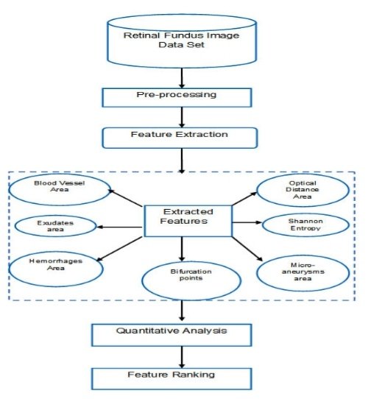
SYSTEM ARCHITECTURE
The most important goal of this phase is to develop the model. The work in this phase should be much more straightforward as a result of the work done in the planning and design phases. This phase involves changing design specifications into executable programs. When the design is there, developers can have an idea on looks of application. All that is needed by developers is to put them at one place to understand about the intended project.

Slide 7
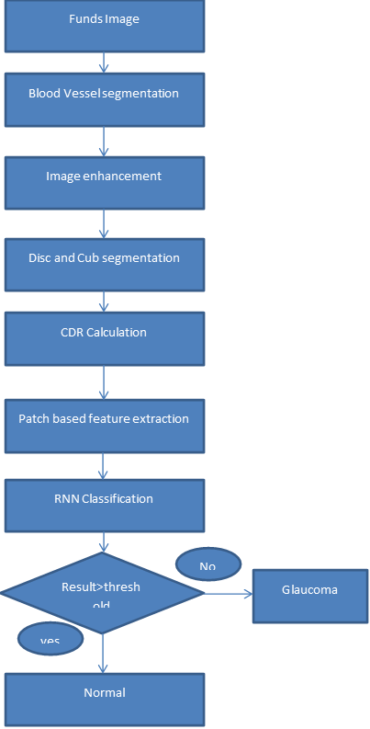
SYSTEM DESIGN
FLOW CHART

Slide 8
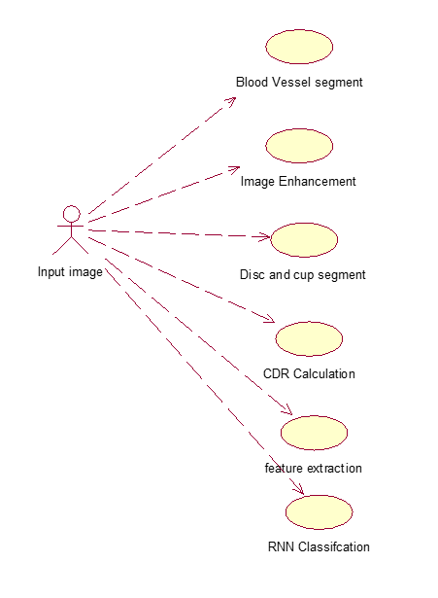
USE CASE DIAGRAM

Slide 9
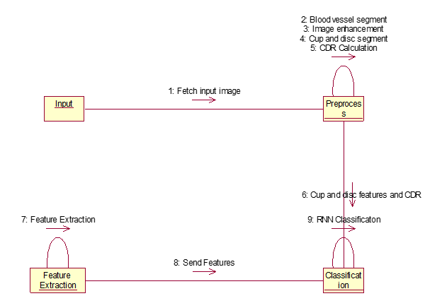
COLLABORATION DIAGRAM

Slide 10
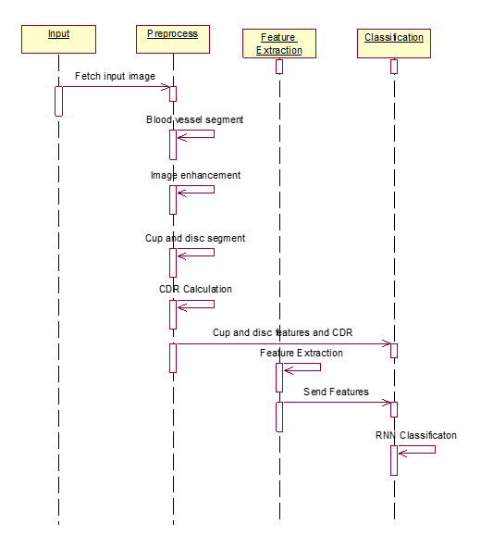
SEQUENCE DIAGRAM

Slide 11
MODULE DESCRIPTION
Image enhancement
Image enhancement refers to the process of highlighting certain information of an image, as well as weakening or removing any unnecessary information according to specific needs. For example, eliminating noise, revealing blurred details, and adjusting levels to highlight features of an image. Image enhancement is the procedure of improving the quality and information content of original data before processing. Common practices include contrast enhancement, spatial filtering, density slicing, and FCC. Image enhancement is important because of its usefulness in virtually all image processing applications. Image enhancement tools are often classified into (a) point operations, and (b) spatial operators. Point operations include contrast stretching, noise clipping, histogram modification, and pseudocoloring.

Slide 12
Blood vessel segmentation
A method for blood vessel segmentation in retinal images using morphological reconstruction. The retinal blood vessels is an important indicator for diagnosis of several clinical disorders of eye. A final segmented image is obtained by the application of a two stage post-processing phase.
Optic disc and optic cup segmentation
The optic disc and optic cup segmentation techniques are used to isolate the relevant parts of the retinal image and to calculate the cup-to-disc ratio. The main objective of this paper is to review segmentation methodologies and techniques for the disc and cup boundaries which are utilized to calculate the disc and cup geometrical parameters automatically and accurately to help the professionals in the glaucoma to have a wide view and more details about the optic nerve head structure using retinal fundus images.

Slide 13
CDR Calculation
Detecting the optic disc and cup from a fundus image and calculating the CDR value is a method used to identify glaucoma in its early stages. In this paper we have proposed an automatic process to locate the optic disc and the optic cup from the retinal image. ... This is the brightest region of the fundus image.
Feature Extraction
The features are used to classify the images as normal and glaucoma. The algorithm speed increases by applying the technique on region of interest instead of using complete image directly.

Slide 14
RNN Classification
Significant learning structures, for instance, Recurrent neural frameworks (CNNs), can translate a different leveled depiction of pictures to isolate among glaucoma and non-glaucoma plans for characteristic decisions. The proposed DL configuration contains unmistakable academic layers: like Recurrent layers and totally related layers. Dropout and Pooling layers frameworks are grasped to also help the execution of glaucoma finding. Wide trials are performed on the unmistakable datasets. The results show locale under the curve of the beneficiary working trademark twist in glaucoma acknowledgment in the two databases, much better than bleeding edge computations. The strategy could be used for glaucoma distinguishing proof.

Slide 15
SYSTEM TESTING
Unit testing :
Unit testing involves the design of test cases that validate that the internal program logic is functioning properly, and that program inputs produce valid outputs. All decision branches and internal code flow should be validated. Unit tests perform basic tests at component level and test a specific business process, application, and/or system configuration.
Integration testing :
Integration tests are designed to test integrated software components to determine if they actually run as one program. Testing is event driven and is more concerned with the basic outcome of screens or fields. Integration tests demonstrate that although the components were individually satisfaction, as shown by successfully unit testing, the combination of components is correct and consistent.
Functional test :
Functional tests provide systematic demonstrations that functions tested are available as specified by the business and technical requirements, system documentation, and user manuals.
Functional testing is centered on the following items:
Valid Input : identified classes of valid input must be accepted.
Invalid Input : identified classes of invalid input must be rejected.
Functions : identified functions must be exercised.
Output : identified classes of application outputs must be exercised.
Systems/Procedures : interfacing systems or procedures must be invoked.
Before functional testing is complete, additional tests are identified and the effective value of current tests is determined.

Slide 16
System Test :
System testing ensures that the entire integrated software system meets requirements. It tests configuration to ensure known and predictable results. An example of system testing is the configuration oriented system integration test. System testing is based on process descriptions and flows, emphasizing pre-driven process links and integratgration.
. White Box Testing :
White Box Testing is a testing in which in which the software tester has knowledge of the inner workings, structure and language of the software, or at least its purpose. It is purpose. It is used to test areas that cannot be reached from a black box level.
Black Box Testing :
Black Box Testing is testing the software without any knowledge of the inner workings, structure or language of the module being tested. Black box tests, as most other kinds of tests, must be written from a definitive source document, such as specification or requirements document, such as specification or requirements document. It is a testing in which the software under test is treated, as a black box .you cannot “see” into it. The test provides inputs and responds to outputs without considering how the software works.
Unit Testing :
Unit testing is usually conducted as part of a combined code and unit test phase of the software lifecycle, although it is not uncommon for coding and unit testing to be conducted as two distinct phases.

Slide 17
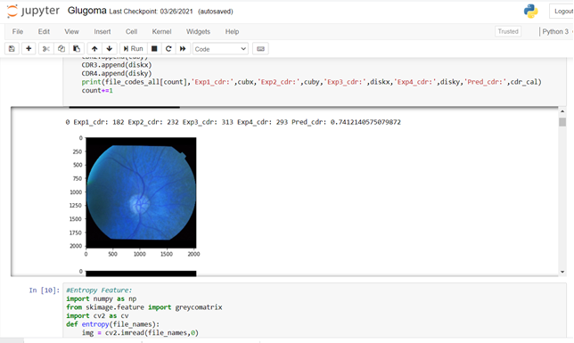
SCREENSHOTS
Fig 1. Primary Eye Screenshot

Slide 18
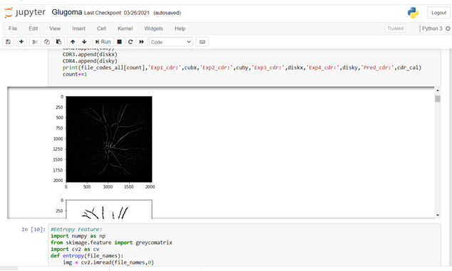
Fig 2. Black Scale Screenshot

Slide 19
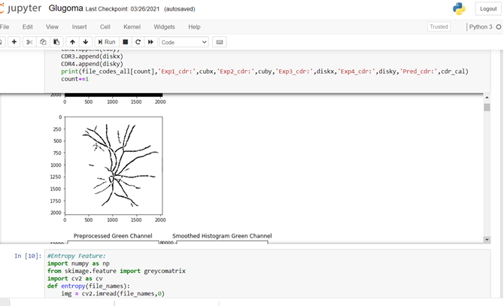
Fig 3. Gray scale Screenshot

Slide 20
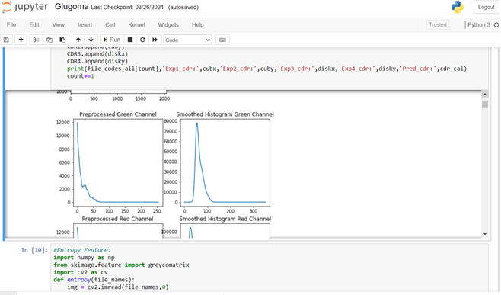
Fig 4.Preprocessed green and Smoothed Histogram Green channel Screenshot

Slide 21
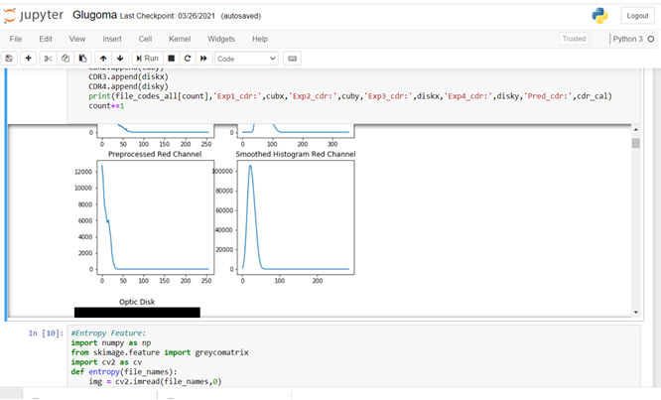
Fig 5.Preprocessed Red and Smoothed Histogram Red channel Screenshot

Slide 22
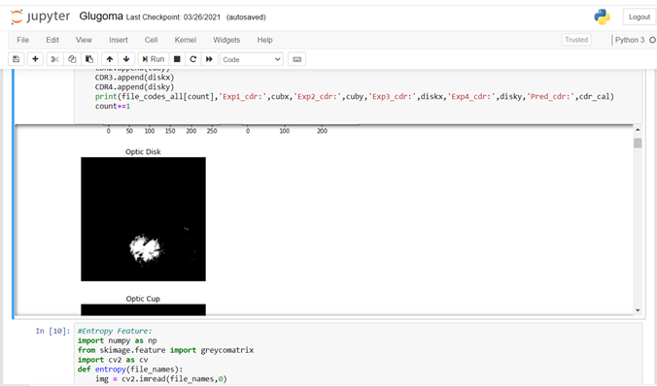
Fig 6. Normal Optic Disk Nerve

Slide 23
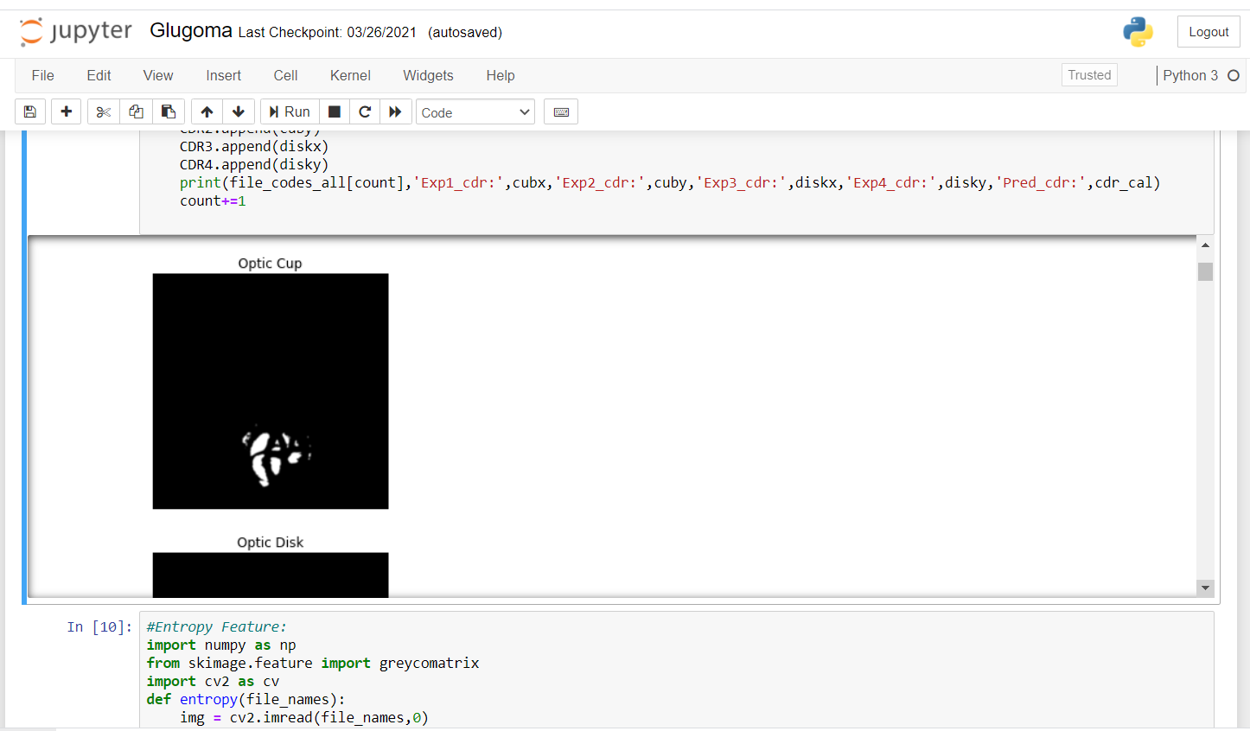
Fig 7. Normal Optic Cup Nerve

Slide 24
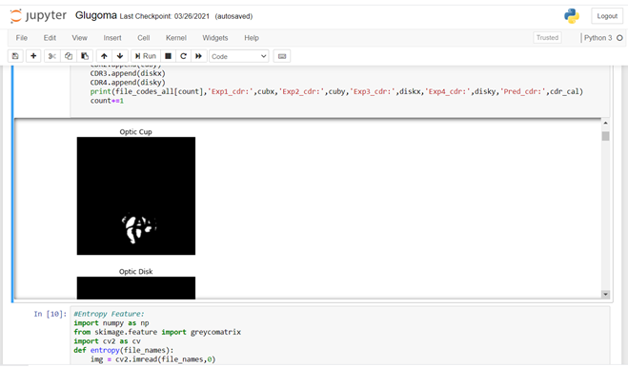
Fig 8. Moderate Optic Cup Nerve

Slide 25
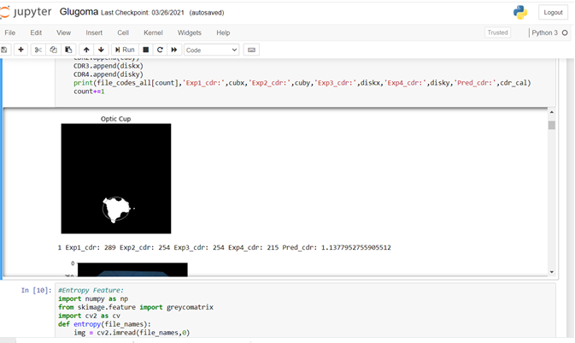
Fig 9. Advanced Optic Cup Nerve

Slide 26
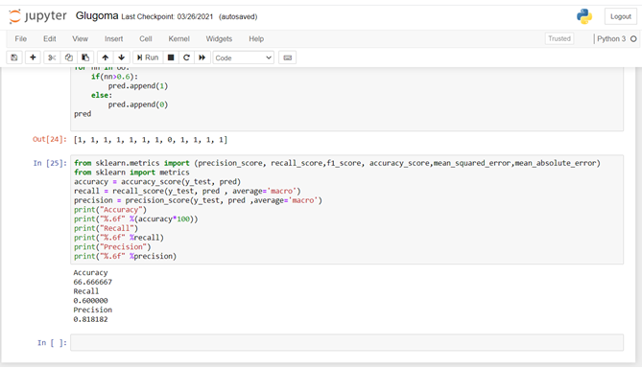
Fig 10. Output Screenshot

Slide 27
CONCLUSION
FUTURE WORK
This study brings evidence that deep neural networks are available methodology for medical imaging, even though they solve the task in question in a different way than virtually all well documented past work.An average accuracy of 95.64% is determined in the classification of blood vessel or not. Optic cup is also segmented from the optic disc by Fuzzy C Means Clustering (FCM). This proposed algorithm is tested on a sample of hospital images and CDR value is determined. The obtained values of CDR is compared with the given values of the sample images and hence the performance of proposed system in which Recurrent Neural Networks for segmentation is employed, is excellent in automated.
We will convert that model into real time application for detection of GLAUCOMA. The application will be easy to access to each person

Slide 28
REFERENCES
Donghyeon Kim*, Heejin Park, Jeasoo Kim, Joo Young Hahn, Joung-Soo Park ” MIMO Communication Based on Adaptive Passive Time Reversal in Deep Water” IEEE access 2019
M. Leeson and M. Higgins, “Optical wireless and millimeter waves for 5g access networks,” in The Fifth Generation (5G) of Wireless Communication. IntechOpen, 2018.
Jeneel Pravin Kachhadiya, Abhinav Kashyap “Air-Water Optical Communication using an Airborne Radio controlled Aircraft” IEEE access 2018
T. D. P. Perera, D. N. K. Jayakody, S. K. Sharma, S. Chatzinotas, and J. Li, “Simultaneous wireless information and power transfer (swipt):Recent advances and future challenges,” IEEE Communications Surveys & Tutorials, vol. 20, no. 1, pp. 264–302, 2017.
Yuezhong Li, Xiaoqiang Yan, Lingyuan Zeng, Hualing Wu”Research on Water Meter Reading System Based on LoRa Communication” IEEE access 2017
H. Kaushal and G. Kaddoum, “Underwater optical wireless communication,” IEEE access, vol. 4, pp. 1518–1547, 2016.
C. Gussen, P. Diniz, M. Campos, W. A. Martins, F. M. Costa, and J. N. Gois, “A survey of underwater wireless communication technologies,” J. Commun. Inform. Sys, vol. 31, no. 1, 2016.

Slide 29
PUBLICATIONS DETAILS
T. Khalil, S. Khalid, A. M. Syed, ”Review of Machine Learning Techniques for Glaucoma Detection and Prediction”, Science and Information Conference 2014, London, UK, 438
S. J. Kim, K. J. Cho and S. Oh, “Development of machine learning models for diagnosis of glaucoma”, https://doi.org/10.1371/journal.pone.0177726 May 23, 2017
R. Daneshvar, A. Yarmohammadi, R. Alizadeh, S. Henry, S. Law, J. Caproli, and K. Mahdavi, “Prediction of Glaucoma Progression with Structural Parameters: Comparison of Optical Coherence Tomography and Clinical Disc Parameters”, American Journal of Ophthalmology, December 201913.
T. Khalil, M. U. Akram, S. Khalid, and A. Jameel, “An overview of automated glaucoma detection,” Proc. Comput. Conf. 2017, vol. 2018-January, no. July, pp. 620–632, 2018, DOI: 10.1109/SAI.2017.8252161.
A. Serener and S. Serte, “Transfer Learning for Early and Advanced Glaucoma Detection with Convolutional Neural Networks”, 978-1-7281-2420-9/19/ 2019 IEEE

